Slide 1

HOTELS
ALGARVE
BUSINESS
PLAN

Slide 2
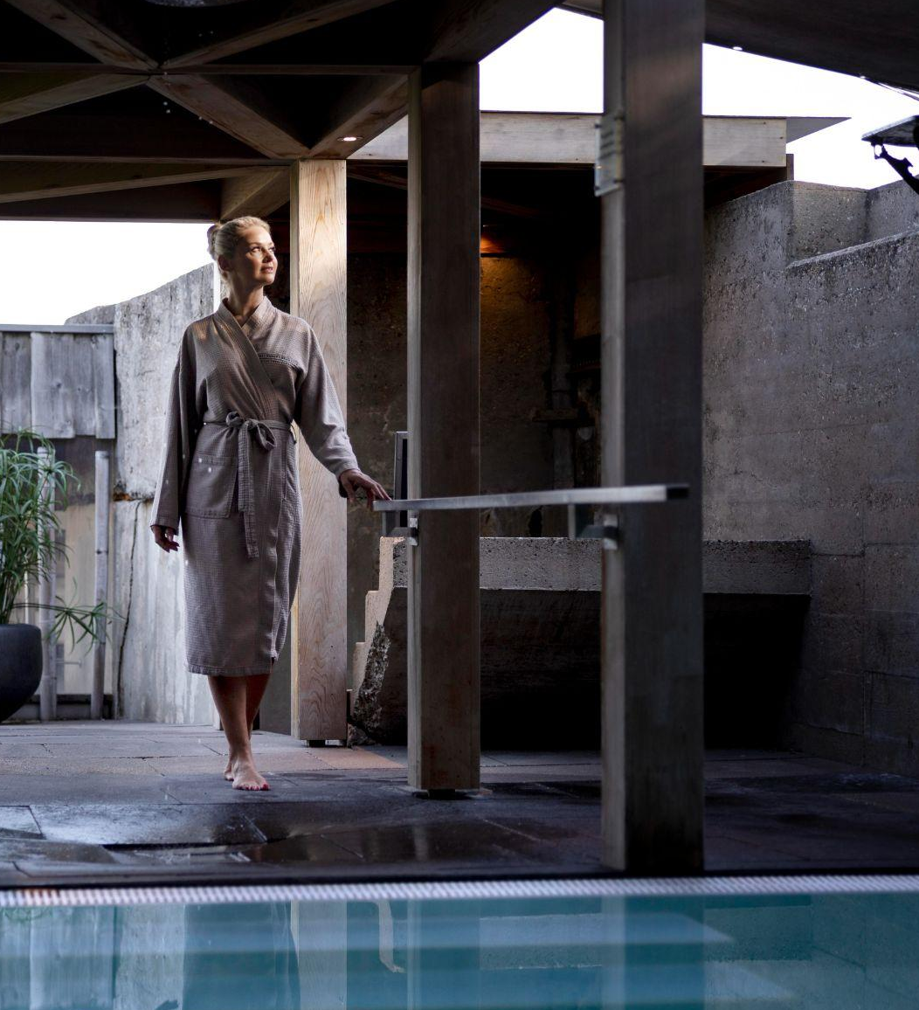
LUXURY RESORT HOTEL & CITY HOTEL
Pine Cliffs Hotel, a Luxury Collection Resort is situated in Albufeira, Portugal.
3HB Faro is located in the heart of Faro, Portugal, within the city's historic center.
HOTELS
PINE CLIFFS &
3HB FARO

Slide 3
DATA ANALYSIS PROCESS
Dataset
Cleaning
EDA
Observations
Visualising

Slide 4
DATASET SNAPSHOT
 | Hotel | Company | Agent
1 | Resort Hotel | NULL | NULL
2 | City Hotel | NULL | 8
3 | City Hotel | 110 | 9
4 | Resort Hotel | NULL | NULL

Slide 5
LIBRARIES
NUMPY
SEABORN
PANDAS
MATPLOTLIB
FOLIUM
Notes:
Breakk

Slide 6
DATA CLEANING
DATA COPY
COPY INFO
DATA TYPE
119390 rows and 32 columns
reservation status date
NULLS
DUPLICATE
children / agent
country
31994 rows

Slide 7
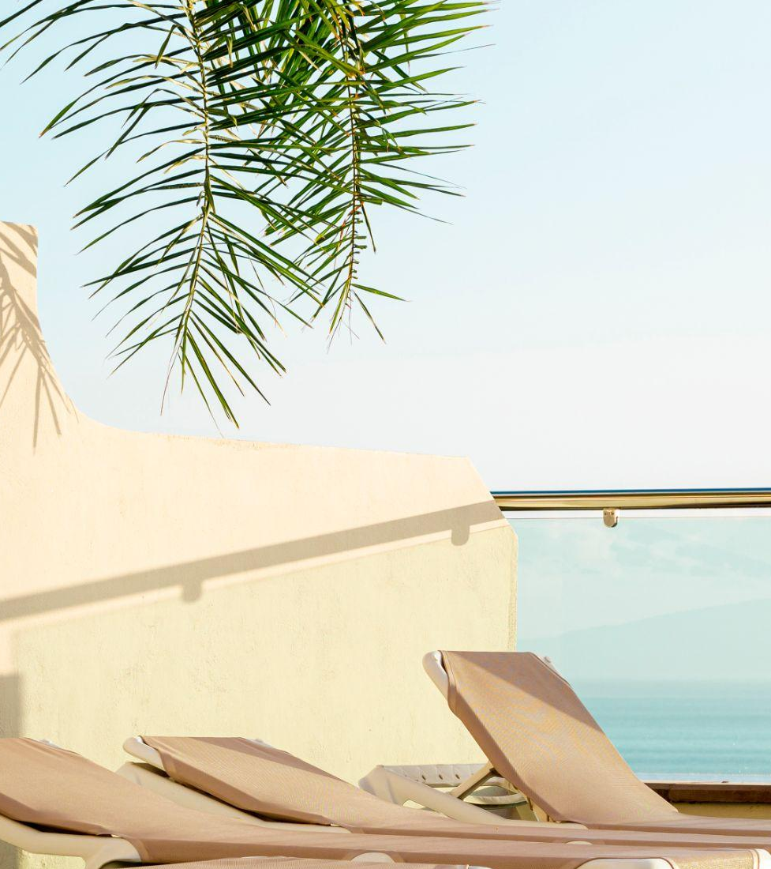
EXPLORATORY DATA ANALYSIS (EDA)
ASKING QUESTIONS / IDENTIFYING PROBLEMS
USING YOUR DATASET / VARIABLES
VISUALIZING

Slide 8
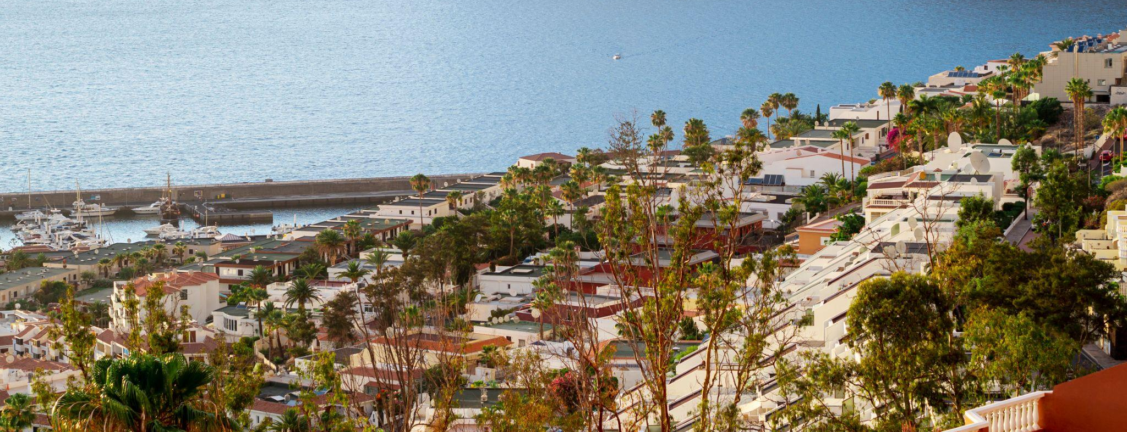
Which type of hotel is mostly prefered by the guests?

Slide 9
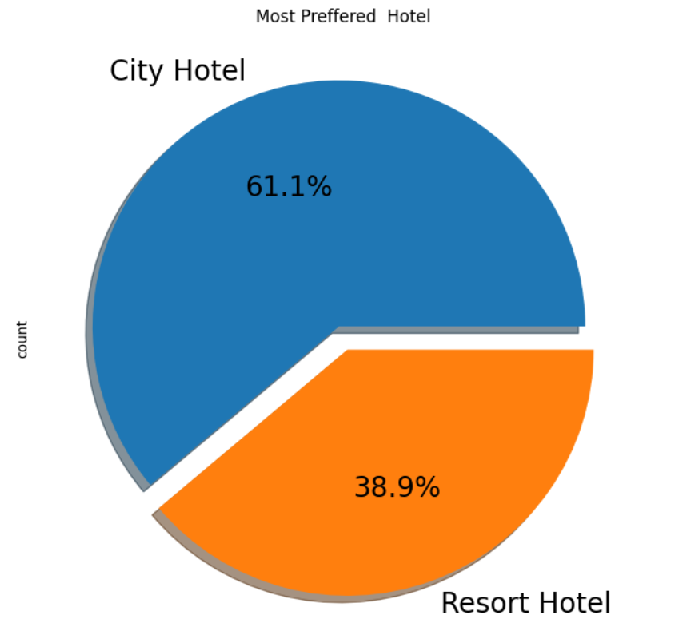

Slide 10

Which Agent made the most bookings?

Slide 11
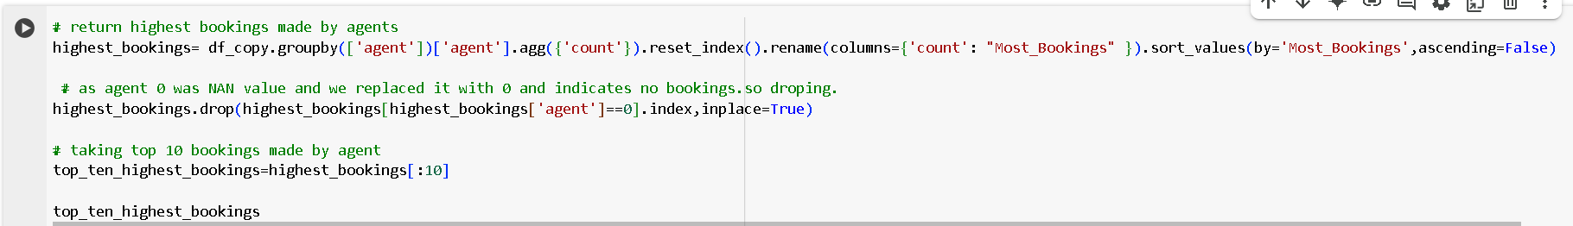
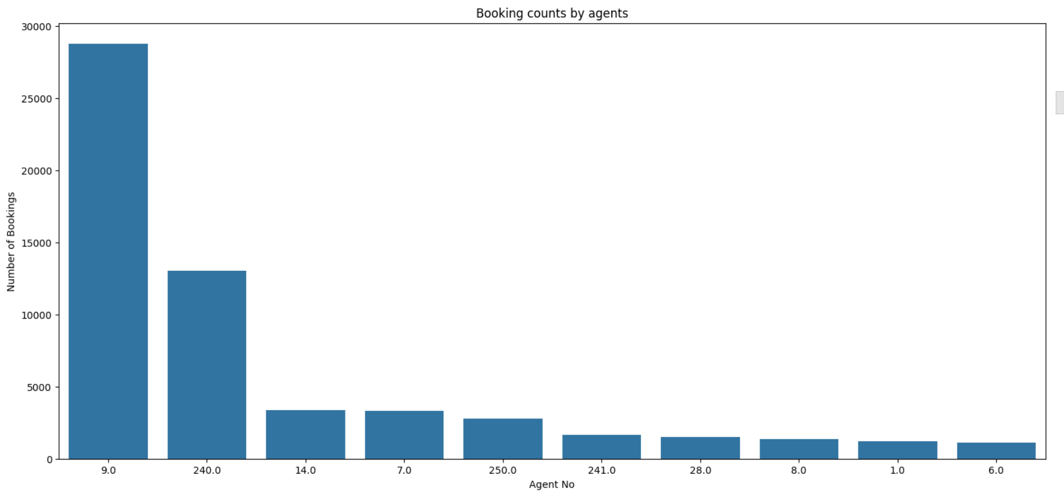

Slide 12
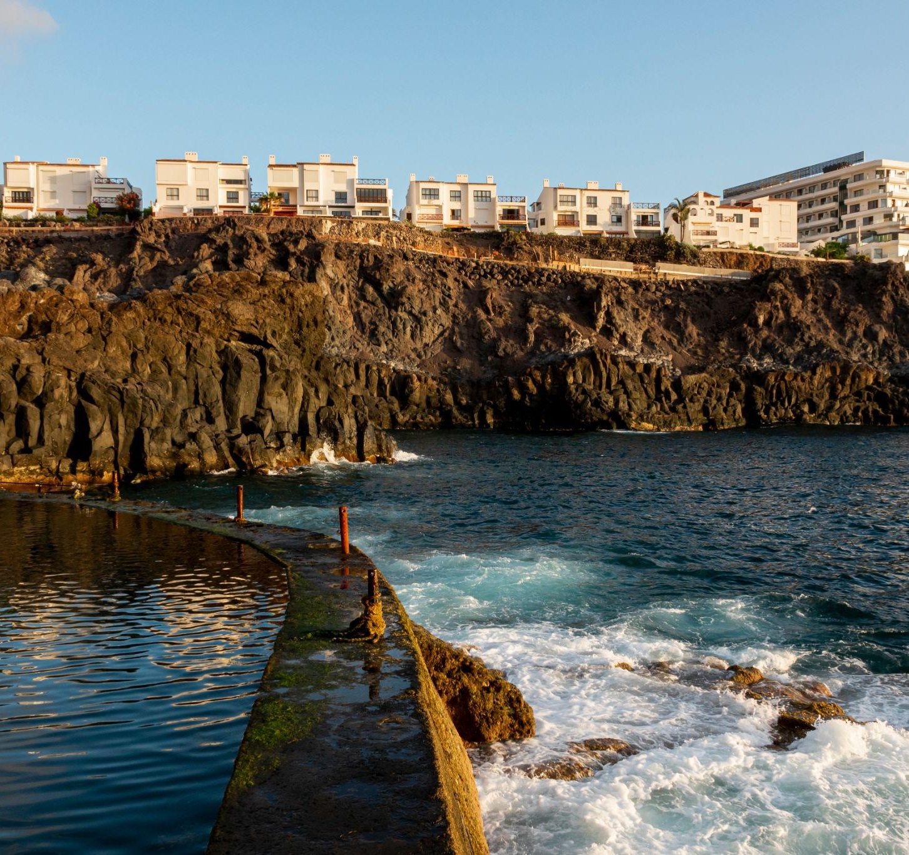
From which country the most guests are coming?

Slide 13
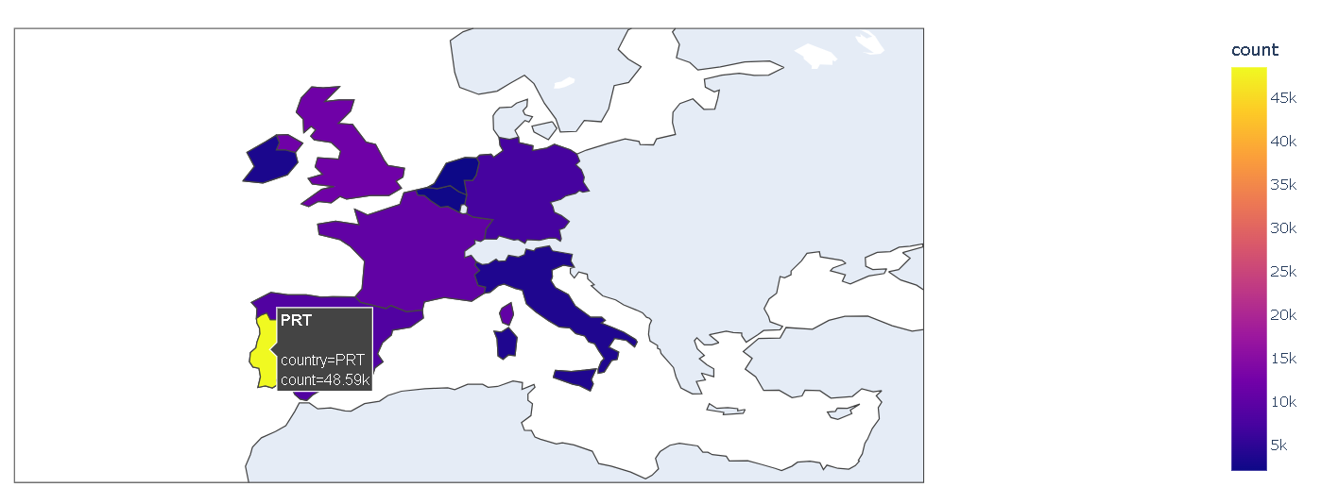

Slide 14
TOP 3 COUNTRIES
PORTUGAL
UK
FRANCE

Slide 15
FINDINGS/OBSERVATIONS
More than 48k guests are from Portugal.
Agent ID no: 9 made most of the bookings between 2015-2017
City Hotel is most preferred hotel by guests.

Slide 16

THANKS!
Please keep this slide for attribution

